Slide 1
ESG DISCLOSURE, BALANCING AND PROPORTIONALITY: TOWARDS THE «CORPORATE SUSTAINABILITY REPORTING DIRECTIVE»
March 10°, 2022
Alberto Mattia Serafin
University of Cassino
alberto.mattiaserafin@unicas.it

Slide 2
PRELIMINARY CLARIFICATIONS
«ESG Disclosure»
«Balancing»
«Proportionality»

Slide 3
1) ESG DISCLOSURE
Mechanism through which companies – voluntarily or compulsorily – make public ESG data.
ENVIRONMENTAL
ESG
SOCIAL
GOVERNANCE

Slide 4
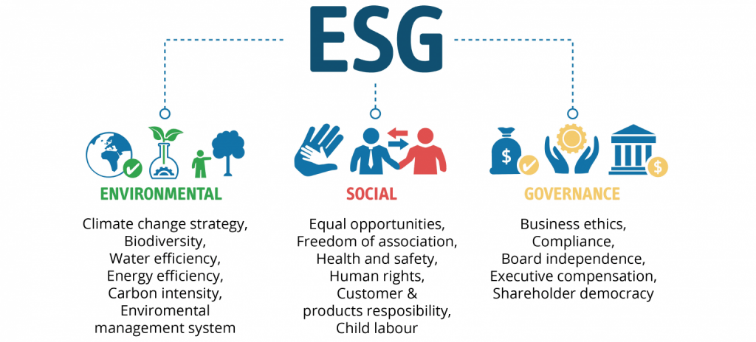

Slide 5
EUROPEAN UNION
MANDATORY DISCLOSURE FOR LARGE UNDERTAKINGS
CURRENT REGIME -> DIRECTIVE 2014/95/EU (SO-CALLED «NON-FINANCIAL REPORTING DIRECTIVE», FROM NOW ON ALSO «NFRD»)
TRANSPOSED INTO NATIONAL (ITALIAN) LAW THROUGH LEGISLATIVE DECREE NO. 254/2016

Slide 6
«CORPORATE SUSTAINABILITY REPORTING DIRECTIVE»
On April 21°, 2021, the Commission adopted a proposal for a «Corporate Sustainability Reporting Directive» (from now on, «CSRD», amending and extending the existing requirements.
[*First reports published in 2024, covering financial year 2023]

Slide 7
2) BALANCING
Balancing consists in finding an equilibrated solution between the two sides of a set of scales, protecting both rights, trying not to sacrifice one in favour of the other; the solution adopted should be the one that allows one of the rights to be applied with the least sacrifice of the other.

Slide 8
3) PROPORTIONALITY
Fundamental principle of the EU legal system
Art 5, para 4, TEU: «Under the principle of proportionality, the content and form of Union action shall not exceed what is necessary to achieve the objectives of the Treaties».
(See also Arts 69, 192, 276 TFEU)

Slide 9
CORPORATE SOCIAL RESPONSIBILITY
H. Fleischer, Corporate Social Responsibility: Vermessung eines Forschungsfeldes aus rechtlicher Sicht, Max Planck Private Law Research Paper No. 18/28, p. 1 ss. -> more that 600.000 papers on SSRN
St. Augustine : «If nobody asks me, I know; but if I were desirous to explain it to one that should ask me, plainly I do not know».

Slide 10
A DEFINITION OF CSR?
«The discussions of the ‘social responsibilities of business’ are notable for their analytical looseness and lack of rigor».
M. Friedman (New York Times, Sept.13, 1970)

Slide 11
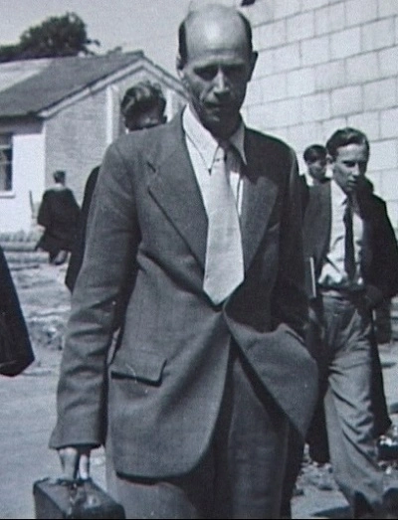
DEFINITIONAL MINIMALISM
A. Okoye, Theorising Corporate Social Responsibility as an Essentially Contested Concept: is a Definition Necessary?, in Journal of Business Ethics, 2009, p. 613 ss.
CSR as an ECC -> Walter Bryce Gallie
ECC -> other examples: «art», «power», «justice»

Slide 12
ESSENTIAL FEATURES OF CSR
Still a «nebulous idea» (K. Davis, Can Business Afford to Ignore Social Responsibilities?, in California Management Review, 1960, p. 70 ss., 70)?
Two «attempts» (Okoye)
«To address various issues which arise out
of the dynamic relationship between corporations
and society over time»
«To achieve the most suitable relationship
between the corporation and society
at the given point in time»

Slide 13
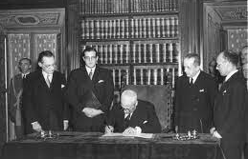
(Italian) principles
ART. 41 CONSTITUTION (OLD TEXT)
- «Private economic enterprise is free.
- It may not be carried out against the common good or in such a manner that could damage safety, liberty and human dignity.
- The law shall provide for appropriate programmes and controls so that public and private-sector economic activity may be oriented and co-ordinated for social purposes.».

Slide 14
ART. 41 (NEW TEXT) CONSTITUTIONAL LAW NO 1/2022
«Private economic enterprise is free.
It may not be carried out against the common good or in such a manner that could damage safety, ENVIRONMENT, liberty and human dignity.
The law shall provide for appropriate programmes and controls so that public and private-sector economic activity may be oriented and co-ordinated for social AND ENVIRONMENTAL purposes.».

Slide 15
Art. 9 Italian constitution
The Republic promotes the development of culture and of scientific and technical research.
It safeguards natural landscape and the historical and artistic heritage of the Nation.
It safeguards the ENVIRONMENT, BIODIVERSITY and ECOSYSTEMS, in the interest of future generations. State laws regulate ways and forms for the protection of ANIMALS.

Slide 16
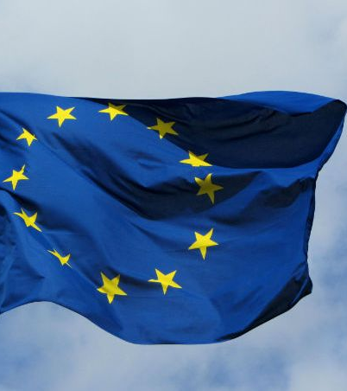
EUROPEAN PRINCIPLES
Art. 3.3 TEU: «The Union shall establish an internal market. It shall work for the sustainable development of Europe based on balanced economic growth and price stability, a highly competitive social market economy […]».
Art. 11 TFEU: «Environmental protection requirements must be integrated into the definition and implementation of the Union's policies and activities, in particular with a view to promoting sustainable development».
Art. 37 CFR: «“A high level of environmental protection and the improvement of the quality of the environment must be integrated into the policies of the Union and ensured in accordance with the principle of sustainable development».

Slide 17
ESG disclosure
NFRD (and CSRD) represent a «concretization» or «hypostatization» of the general principles of (Italian and) European Law
Balanced and proportionate solutions?

Slide 18
THE CURRENT REGIME
NFRD
«SUBJECTIVE» SCOPE
«OBJECTIVE» SCOPE

Slide 19
«SUBJECTIVE SCOPE»
ART. 1 NFRD
«Large undertakings which are public-interest entities exceeding on their balance sheet dates the criterion of the average number of 500 employees during the financial year».
NATIONAL LEGISLATION -> DIFFERENCES IN TRANSPOSITION
[Artt. 1-2 Legislative Decree No. 254/2016 -> further requirements: i) 20.000.000 euros of assets in the balance sheet; ii) 40.000.000 euros of net revenues from sales and services]

Slide 20
«OBJECTIVE» SCOPE (i)
«[…] shall include in the management report a non-financial statement containing information to the extent necessary for an understanding of the undertaking's development, performance, position and impact of its activity, relating to, as a minimum, environmental, social and employee matters, respect for human rights, anti-corruption and bribery matters».

Slide 21
«AS A MINIMUM»
Whereas 5 NFRD: «It is also necessary to establish a certain minimum legal requirement as regards the extent of the information that should be made available to the public and authorities by undertakings across the Union. The undertakings subject to this Directive should give a fair and comprehensive view of their policies, outcomes, and risks».

Slide 22
«OBJECTIVE» SCOPE (II)
«a brief description of the group's business model»
NFS will include
«a description of the policies pursued by the undertaking
in relation to those matters, including due diligence
processes implemented»
«the outcome of those policies»
«the principal risks related to those matters
linked to the undertaking's operations»
«non-financial key performance indicators relevant
to the particular business»

Slide 23
OBJECTIVE SCOPE (III)
Whereas 7 NFRD + Art. 3, para 2, Legislative Decree No. 254/2016
ENVIRONMENT: «details of the current and foreseeable impacts of the undertaking's operations on the environment, and, as appropriate, on health and safety, the use of renewable and/or non-renewable energy, green­ house gas emissions, water use and air pollution»
SOCIAL AND EMPLOYEE-RELATED MATTERS: «the actions taken to ensure gender equality, implementation of funda­ mental conventions of the International Labour Organisation, working conditions, social dialogue, respect for the right of workers to be informed and consulted, respect for trade union rights, health and safety at work and the dialogue with local communities, and/or the actions taken to ensure the protection and the development of those communities».

Slide 24
OBJECTIVE SCOPE (IV)
HUMAN RIGHTS, ANTI-CORRUPTION AND BRIBERY: «information on the prevention of human rights abuses and/or on instruments in place to fight corruption and bribery».
[Further requirements in national legislation]

Slide 25
«OBJECTIVE» SCOPE (v)
Art. I NFRD (and Art. 3, para 6, Legislative Decree no. 254/2016):
«Where the undertaking does not pursue policies in relation to one or more of those matters, the non-financial state­ment shall provide a clear and reasoned explanation for not doing so».

Slide 26
«Comply or explain» mechanism
VOLUNTARY OR COMPULSORY?
CONS: tool to bypass the disclosure obligation
PROS: administrative burdens become reasonable and proportionate

Slide 27
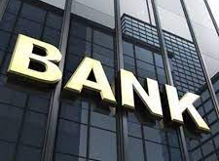
«ONE-SIZE-FITS-ALL» RISK?
«Comparing a bank and a manufacturing company for the level of wastewater produced annually clearly makes little sense»? (M.L. Passador, F. Riganti, Less is More in the Age of Information Overload: the Paradigm Shift From Shareholder- to a Stakeholder-oriented Market, in New York University Journal of Law & Business, 2019, p. 567 ss.)

Slide 28
«PRESUMPTIVE» TECHNIQUE
LINK BETWEEN THE «SUBJECTIVE» AND «OBJECTIVE» SCOPE:
IF YOU ARE A LARGE UNDERTAKING AND PUBLIC-INTEREST COMPANY ETC.
THEN YOU WILL (ARGUABLY) HAVE AN IMPACT ON ENVIRONMENTAL, SOCIAL AND EMPLOYEE MATTERS, RESPECT FOR HUMAN RIGHTS, ANTI-CORRUPTION ETC.

Slide 29
WRONG PRESUMPTION
This legislative technique (generality and abstractness of norms) may fail in two cases:
1) Undertaking NOT falling into the subjective scope (e.g.: 480 employees during the financial year) -> BUT with a huge impact on – for instance – the environment;
II) Undertaking falling into the subjective scope (e.g.: a bank) -> BUT without any (significant) impact on – for instance – the environment itself.
No «remedies» (only voluntary NFS issued pursuant to Art. 7 Legislative Decree no. 254/2016)
«Comply or explain» (reasonable and proportionate solution)

Slide 30
A BREAk: the «EMPIRICAL» PART
1) LIST OF COMPANIES FORMALLY OBLIGED UNDER NATIONAL LEGISLATION: 151 NFSs (3 volunt.)
II) AN EXAMPLE OF NFS (ENEL, 2020)

Slide 31
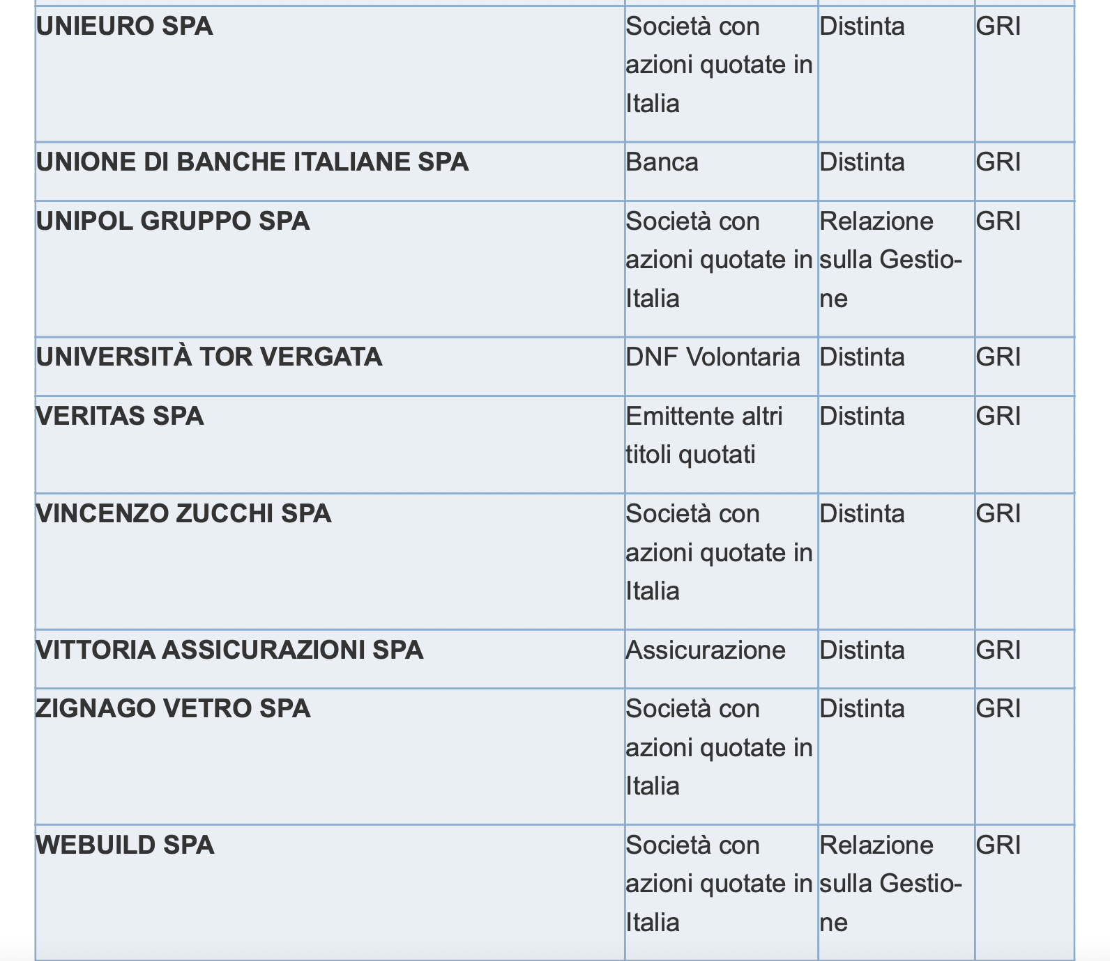
2020 Report on non-financial reporting of Italian listed companies issued by Consob
[https://www.consob.it/documents/46180/46181/rnf2020.pdf/f1370058-d521-4a96-80c5-d64f7a7ac7ff]

Slide 32
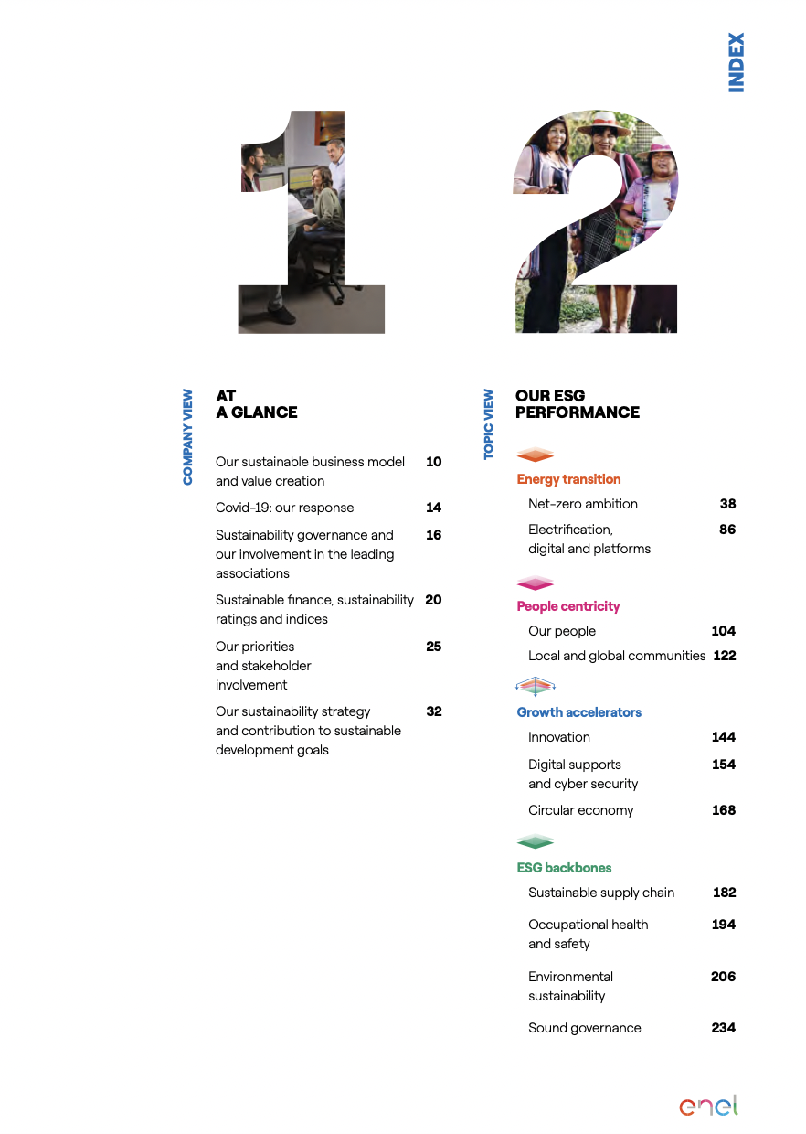

Slide 33
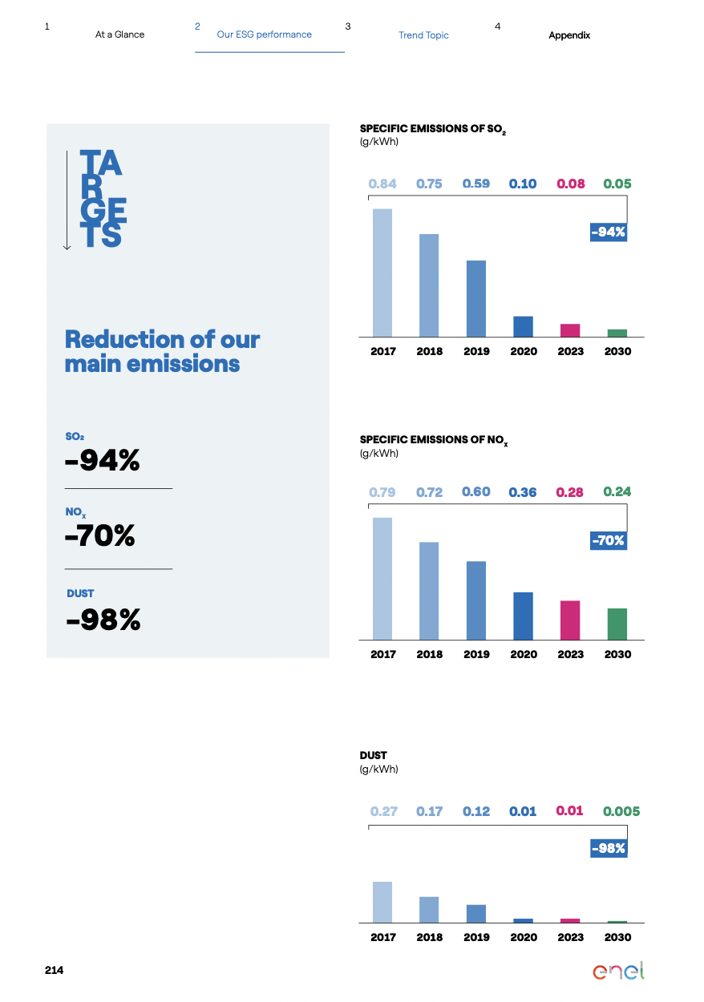

Slide 34
«BACK TO NORMATIVE»: THE NON-BINDING GUIDELINES (I)
Whereas 17 NFRD: «With a view to facilitating the disclosure of non-financial information by undertakings, the Commission should prepare non-binding guidelines, including general and sectoral non-financial key performance indicators. The Commission should take into account current best practices, international developments and the results of related Union initiatives. The Commission should carry out appropriate consultations, including with relevant stake­ holders. When referring to environmental aspects, the Commission should cover at least land use, water use, greenhouse gas emissions and the use of materials»

Slide 35
ACCOMPANYING GUIDELINES
In June 2017, the EU Commission published its guidelines to help companies disclose ENVIRONMENTAL and social information. These guidelines are not mandatory and companies may decide to use international, European or national guidelines according to their own characteristics or business environment.
In June 2019, the EU Commission published guidelines on reporting CLIMATE-RELATED information, which in practice consist of a new supplement to the existing guidelines on non-financial reporting, which remain applicable.

Slide 36
2019 GUIDELINES ON CLIMATE-RELATED INFORMATION
THEY INTRODUCE THE CONCEPT OF «DOUBLE MATERIALITY»:
«FINANCIAL» MATERIALITY
«ENVIRONMENTAL AND SOCIAL» MATERIALITY
M. Täger, ‘Double Materiality’: What is It and Why Does It Matter?, Commentary, 21 April 2021, LSE Grantham Research Institute on Climate Change and the Environment, available online.

Slide 37
«AUThentic interpretation»
Art. 1 NFRD: «Large undertakings which are public-interest entities exceeding on their balance sheet dates the criterion of the average number of 500 employees during the financial year shall include in the management report a non-financial statement containing information to the extent necessary for an understanding of the undertaking's development, performance, position and impact of its activity, relating to, as a minimum […]»

Slide 38
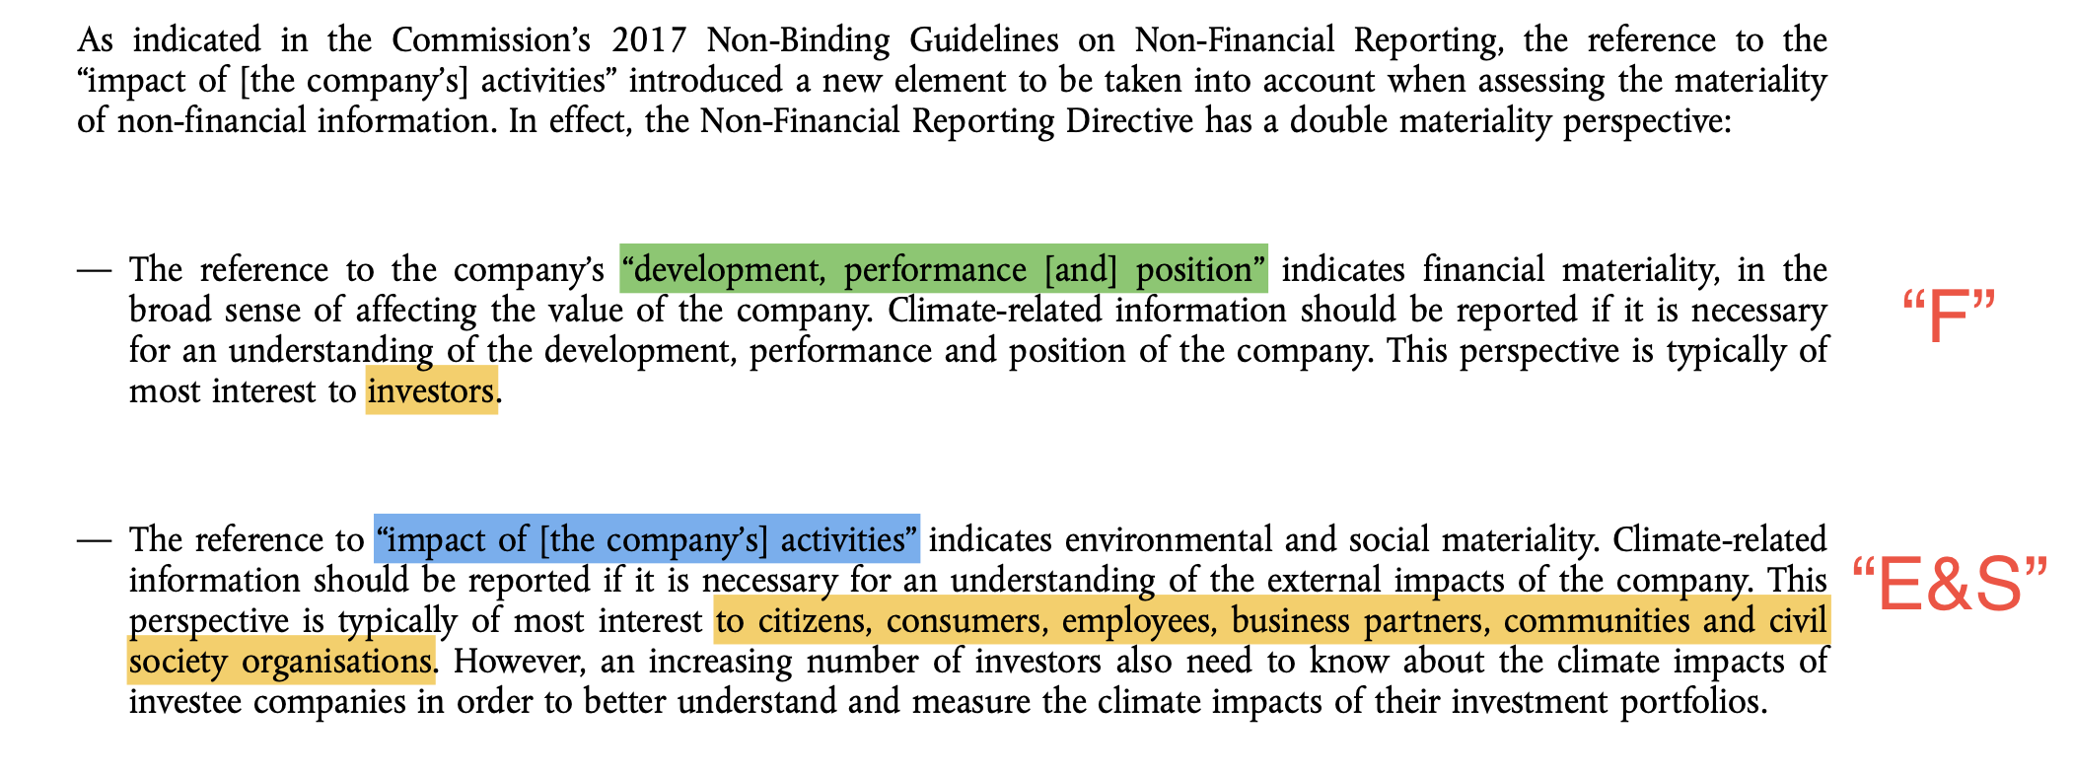
«double MATERIALITY»
«

Slide 41
CURRENT PROBLEMS AFFECTING «NFRD»
The Non-Financial Reporting Directive (NFRD) requires certain large companies to report on social, employee and environmental matters, human rights, bribery and corruption. Currently, the information reported by companies does not meet users’ needs (investors, civil society and others).
Some companies from whom users need information do not report. Even when companies do report, the information is usually not sufficiently relevant, comparable, reliable or easy to access and use. User demand for non-financial information is expected to increase significantly so these problems will intensify.
The lack of adequate non-financial information for investors and civil society creates investment risks, inhibits financial flows to activities that address the sustainability crisis, and creates an accountability gap between companies and society. […] The flexibility and lack of specificity in the NFRD is one reason for this. In addition, there are many overlapping reporting standards and frameworks, and consequently no consensus on what companies should report.

Slide 42
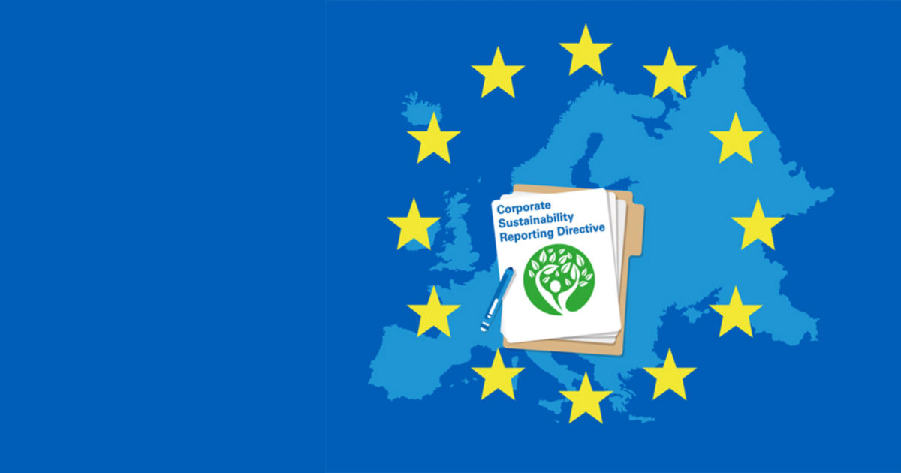
TOWARDS THE «CORPORATE SUSTAINABILITY REPORTING DIRECTIVE» (CSRD)
It will:
- Extend the scope to all large companies and all companies listed on regulated markets (except listed micro-enterprises);
- Require the audit (assurance) of reported information;
- Introduce more detailed reporting requirements, and a requirement to report according to mandatory EU sustainability reporting standards;
- Require companies to digitally ‘tag’ the reported information, so it is machine readable and feeds into the European single access point envisaged in the capital markets union action plan.

Slide 43
Mandated companies
The proposed option would ensure that approximately 49 000 companies report such information (75% of the turnover of all limited liability companies), compared to the current 11 600 companies (47% of the turnover of all limited liability companies).
PROPORTIONALITY!

Slide 44
«PROPORTIONALITY» and administrative SANCTIONS
Art. 8 Legislative Decree No. 254/2016
Not provided at all -> 20.000 to 100.000 euros (reduced to 1/3 if the deposit occurs within 30 days)
Not compliant (in general) -> 20.000 to 100.000 euros
Not true or omission of «material» facts -> 50.000 to 150.000 euros (+ potential criminal sanctions)

Slide 45
THANK YOU FOR YOUR ATTENTION!

